Slide 1
Terraform Associate Certification Preparation 2020
Certification Overview
CONFIDENTIAL | © 2020 EPAM Systems, Inc.

Slide 2
Exam Objectives
Module 1: Terraform Basics.
Module 2 : Deploying infrastructure with Terraform.
Module 3: Read, generate and modify configurations.
Module 4: Terraform modules and workspaces.
Module 5: Remote state management.
Module 6: Terraform cloud and enterprise capabilities.

Slide 3
Module 1: Terraform basics.

Slide 4

What is IaC?
Infrastructure as Code is described using a high-level configuration syntax. This allows a blueprint of your datacenter to be versioned and treated as you would any other code. Additionally, this infrastructure can be shared and re-used.
Advantages
IaC makes it easy to provision and apply infrastructure configurations as code, instead of creating it by hand, which saves time.
It standardizes workflows across different infrastructure providers (e.g., VMware, AWS, Azure, GCP, etc.) by using a common syntax across all of them.
IaC makes it easy to understand the intent of infrastructure changes, because it can span multiple files, allowing human operators to organize the code based on the intent.
IaC makes changes idempotent, consistent, repeatable, and predictable.
Since Terraform can be represented as Code, the configuration of Infrastructure can be saved in Version Control.

Slide 5
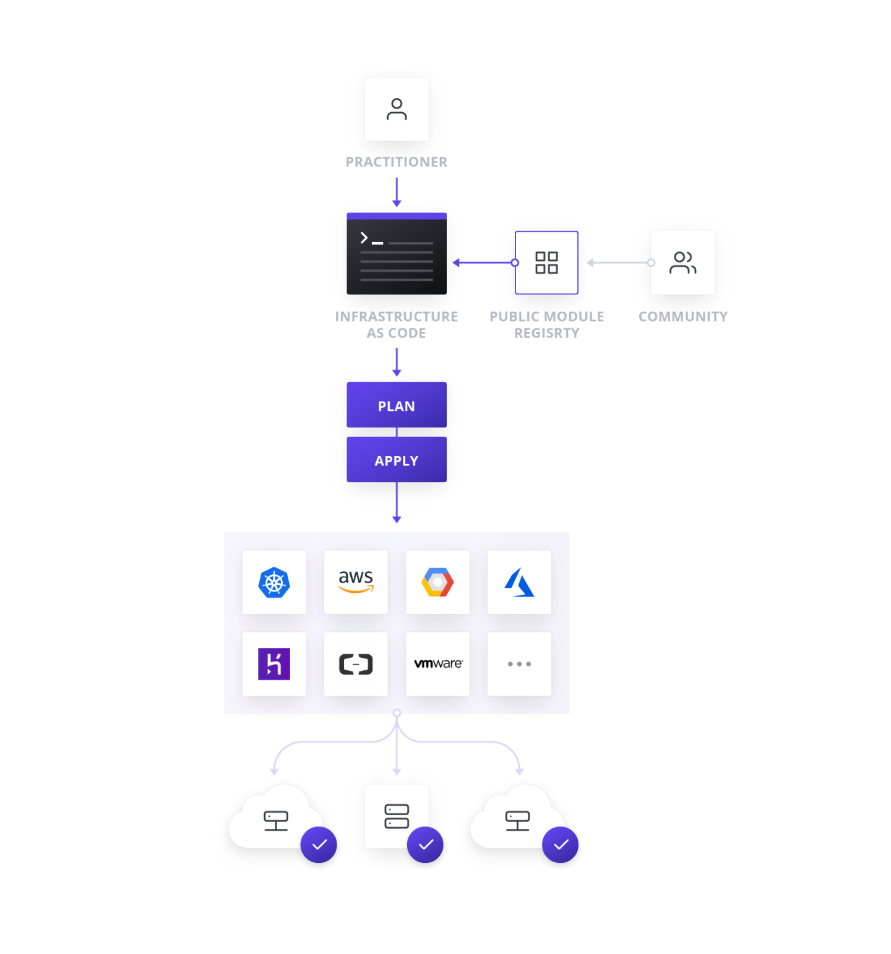
What is Terraform?
Terraform with Multi-cloud
Terraform is a tool for building, changing, and versioning infrastructure safely and efficiently. Terraform can manage existing and popular service providers as well as custom in-house solutions.
It is highly recommended to spread infrastructure across multiple cloud providers to increase fault-tolerance as it allows a more graceful recovery of the loss of a region or entire provider.
Terraform is cloud-agnostic and allows a single configuration to be used to manage multiple providers, and to even handle cross-cloud dependencies. This simplifies management and orchestration, helping operators build large-scale multi-cloud infrastructures.

Slide 6
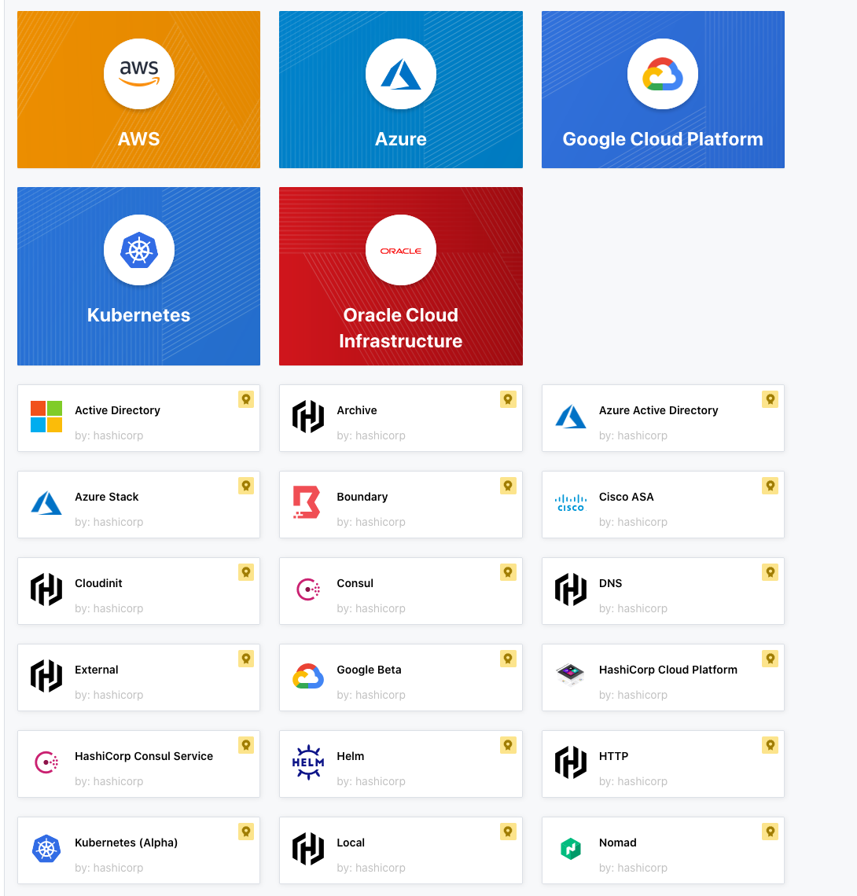
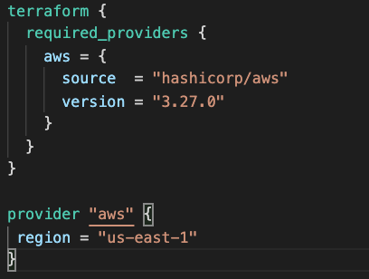
Terraform and Providers Installation
What is a provider?
Supported providers (And many more)
Providers are plugins. They are released on a separate rhythm from Terraform itself, and each provider has its own series of version numbers.
Terraform configurations must declare which providers they require, so that Terraform can install and use them.

Slide 7
Community Providers
Third-party providers are built by the community of Terraform users and vendors. These providers are not tested nor officially maintained by HashiCorp.
*Terraform cannot download providers that are not distributed by HashiCorp (3rd party).
Use Cases:
Official provider does not support specific functionality
Some organization might have proprietary platforms for which they want to use Terraform
Third-party providers must be manually installed by placing plugin executables in the user plugins directory.
Operating System | User plugins dir
Windows | %APPDATA%\terraform.d\plugins
Other OS | ~/.terraform.d/plugins

Slide 8
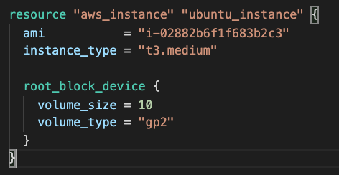
Configuration file
Resource Type
Resource
Resource Name
Argument
Argument Value
Block Argument

Slide 9
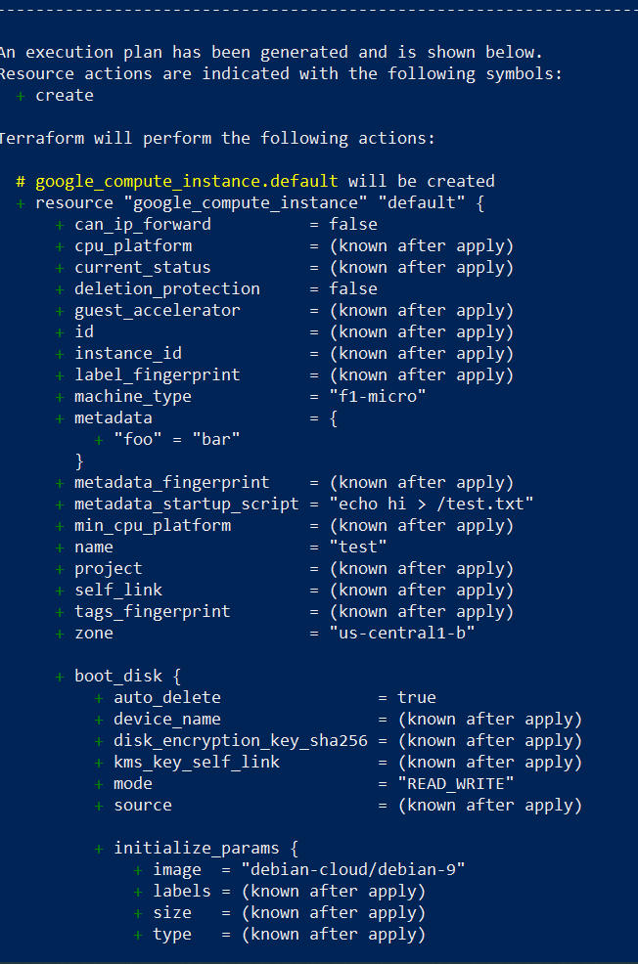
Terraform Plan
The terraform plan command is used to create an execution plan of the infrastructure you've defined. Terraform performs a refresh, unless explicitly disabled, and then determines what actions are necessary to achieve the desired state that is specified in the configuration files.
Common flags:
-out=path
-refresh=true
-var-file=foo
-var 'foo=bar'
-target=resource

Slide 10
Terraform Apply Terraform Destroy
The terraform apply command is used to apply the changes required to reach the desired state of the configuration, or the pre-determined set of actions generated by a terraform plan execution plan.
Common flags:
-auto-approve
-target=resource
-var 'foo=bar'
-var-file=foo
The terraform destroy command is used to destroy the Terraform-managed infrastructure.
Common flags:
-auto-approve
-target=resource
-var 'foo=bar'
-var-file=foo

Slide 11
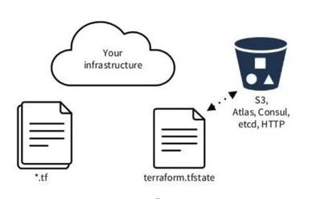
State
When working with Terraform, the tool will eventually need somewhere to store and manage the configuration of the Infrastructure it creates, changes and destroys.
That is where Terraform state comes into play. Terraform state helps by mapping the Infrastructure configuration and metadata into a state file.
The place where all of the operations are performed and where state snapshots are stored is in the Terraform backend.

Slide 12
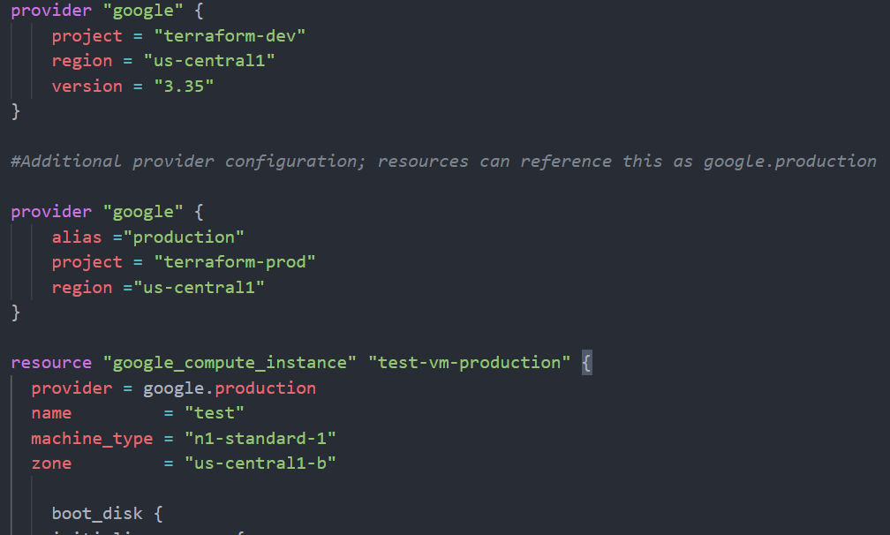
Multiple providers
You can optionally define multiple configurations for the same provider and select which one to use on a per-resource or per-module basis.

Slide 13
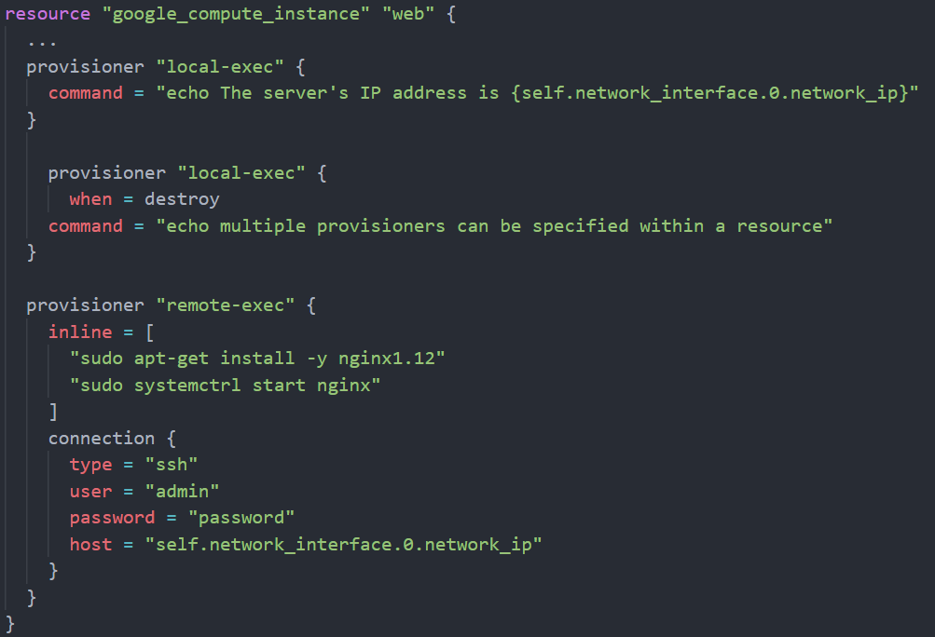
Provisioners
Provisioners are used to execute scripts on local or remote machines as part of their creation or destruction process.
Expressions in provisioner blocks cannot refer to their parent resource by name. Instead, they can use the special self object.
The self object represents the provisioner parent resource and has all its attributes.
By default, provisioners run when the resource they are defined within is created. Creation-time provisioners are only run during creation, not during updating or any other lifecycle.
The remote-exec provisioner supports both ssh and winrm type connections

Slide 14
Terraform Commands
Terraform is controlled via a very easy to use command-line interface (CLI). Terraform is only a single command-line application: terraform. This application then takes a subcommand such as "apply" or "plan". The complete list of subcommands is in the navigation to the left.
Common commands:
apply console destroy env
fmt import workspace
init output
plan refresh show
taint untaint validate version
All other commands:
force-unlock push state
0.12upgrade debug
*Pass the flag –h to the relevant subcommand to get more information.

Slide 15

Terraform Show
The terraform show command is used to provide human-readable output from a state or plan file. This can be used to inspect a plan to ensure that the planned operations are expected, or to inspect the current state as Terraform sees it.
Terraform fmt
The terraform fmt command is used to rewrite Terraform configuration files to a canonical format and style. This command applies a subset of the Terraform language style conventions, along with other minor adjustments for readability. [LAB AVAILABLE]
Terraform force-unlock
This command does not modify the infrastructure, this command removes the lock on the state for the current configuration.
This is used mostly when some sort of quirk occurs while applying or destroying infrastructure and the state lock is not released as it does normally.

Slide 16
Terraform taint
The terraform taint command manually marks a Terraform-managed resource as tainted, forcing it to be destroyed and recreated on the next apply. [LAB AVAILABLE]
Terraform untaint
The terraform untaint command manually unmarks a Terraform-managed resource as tainted, restoring it as the primary instance in the state. This reverses either a manual terraform taint or the result of provisioners failing on a resource.
This command will not modify infrastructure but does modify the state file in order to unmark a resource as tainted. [LAB AVAILABLE]
Terraform validate
Validate runs checks that verify whether a configuration is syntactically valid and internally consistent, regardless of any provided variables or existing state. It is thus primarily useful for general verification of reusable modules, including correctness of attribute names and value types.

Slide 17
Module 2: Deploying Infrastructure with Terraform

Slide 18
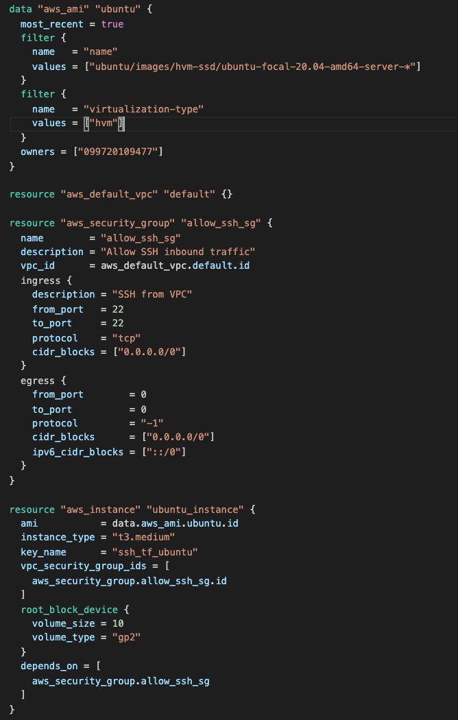
Linking Resources
When working with resources in a Terraform project, you can link resources by performing a reference to one of the Resource or Data Source arguments. Then Terraform will try and handle all the dependencies between linked resources by itself, if you need to specify an explicit dependency, you use the depends_on block.
data.data_source.source_name.argument
resource_type.resource_name.argument
resource_type.resource_name

Slide 19
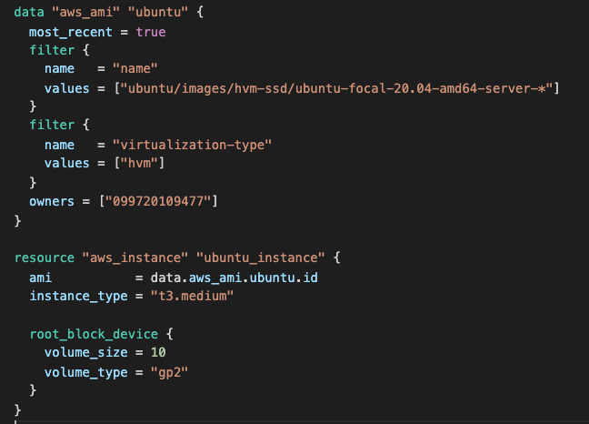
Data Sources
Data sources allow data to be fetched or computed for use elsewhere in Terraform configuration. Use of data sources allows a Terraform configuration to make use of information defined outside of Terraform or defined by another separate Terraform configuration. E.g., Resources not managed by Terraform such as the Cloud public images.
Most of the items within the body of a data block are defined by and specific to the selected data source.
*When using information from a Data sources you need to add the data prefix to let Terraform know you are not using a Resource information-

Slide 20
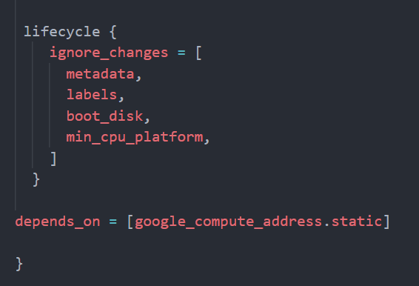
Meta-parameters
count: The number of identical resources to create. This doesn't apply to all resources.
depends_on: Explicit dependencies that this resource has. These dependencies will be created before this resource.
provider: The name of a specific provider to use for this resource. The name is in the format of TYPE.ALIAS, for example, aws.west. Where west is set using the alias attribute in a provider
Lifecycle: - Customizes the lifecycle behavior of the resource:
create_before_destroy
prevent_destroy
ignore_changes

Slide 21
Module 3: Read, generate and modify configurations

Slide 22
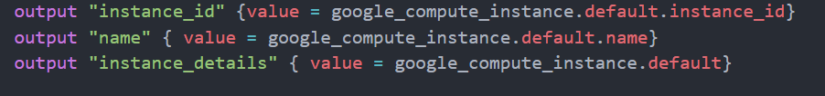
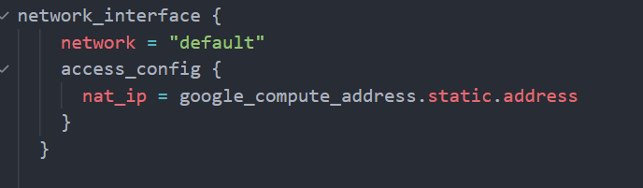
Attributes and Outputs
Terraform has the capability to output the attribute of a resource with the help of output values.
An outputted attribute can not only be used for a user to reference it, but it can also act as an input to other resources being created via Terraform.

Slide 23
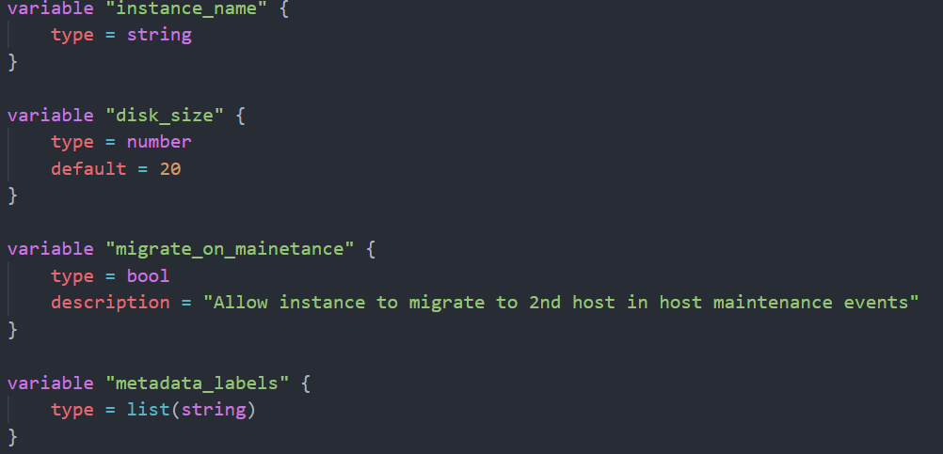
Variables
Input variables serve as parameters for a Terraform module, allowing aspects of the module to be customized without altering the module's own source code, and allowing modules to be shared between different configurations.
When you declare variables in the root module of your configuration, you can set their values using CLI options and environment variables.
The type argument in a variable block allows you to restrict the type of value that will be accepted as the value for a variable. If no type constraint is set, then a value of any type is accepted.
The name of a variable can be any valid identifier except the following:
source
version
providers
count
for_each
lifecycle
depends_on
locals

Slide 24
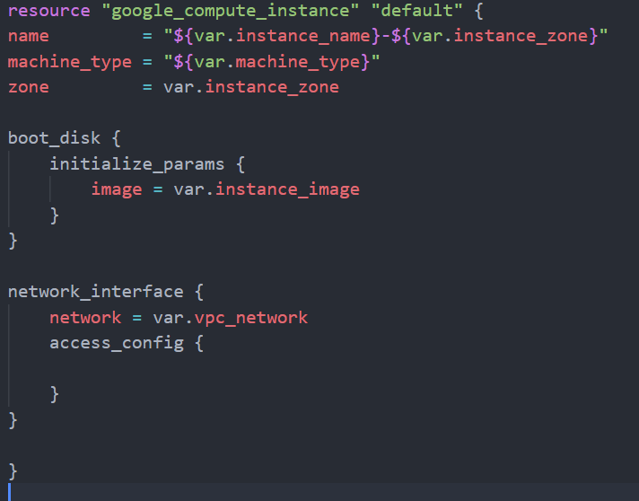
Using Variables
Not only we need to declare the variables we are using but we also need to assign a value to them , there are 3 supported methods for this:
Variables on the command line
To specify individual variables on the command line, use the -var option when running the terraform plan and terraform apply commands
Variable definition (.tfvars) files
To set lots of variables, it is more convenient to specify their values in a variable definitions file (with a filename ending in either .tfvars or .tfvars.json) and then specify that file on the command line with -var-file
*Terraform also automatically loads specific variable definition files
terraform.tfvars or terraform.tfvars.json
Any file ending in .auto.tfvars or .autotfvars.json
Environment variables
As a fallback for the other ways of defining variables, Terraform searches the environment of its own process for environment variables named TF_VAR_ followed by the name of a declared variable.

Slide 25
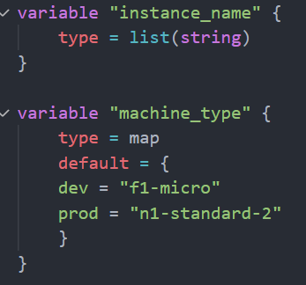
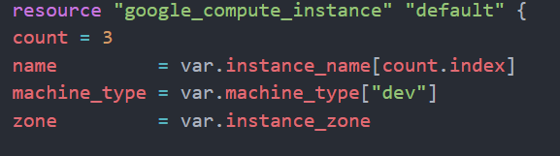
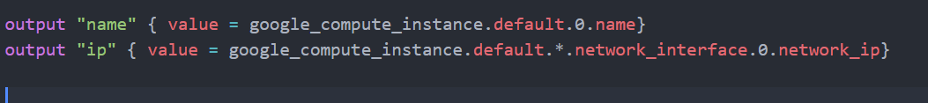
Maps and Lists
Using List and Maps
Define variable type
Fetch all or specific values
Assign string value

Slide 26
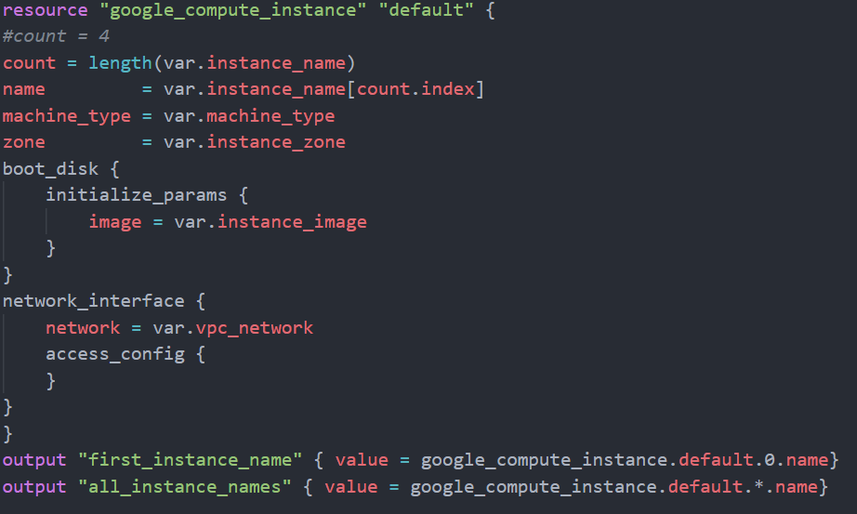
Count and Count Index
Terraform does not have for-loops or other traditional procedural logic built into the language, so this syntax will not work. However, every Terraform resource has a meta-parameter you can use called count. This is Terraform's oldest, simplest, and most limited iteration construct: all it does is define how many copies of the resource to create.
When you use the count parameter in your configuration and index argument is also available to use: Resource count starts at 0
You can use * to specify all members of an array
The length function determines the length of a given list, map, or string.
If given a list or map, the result is the number of elements in that collection. If given a string, the result is the number of characters in the string.

Slide 27
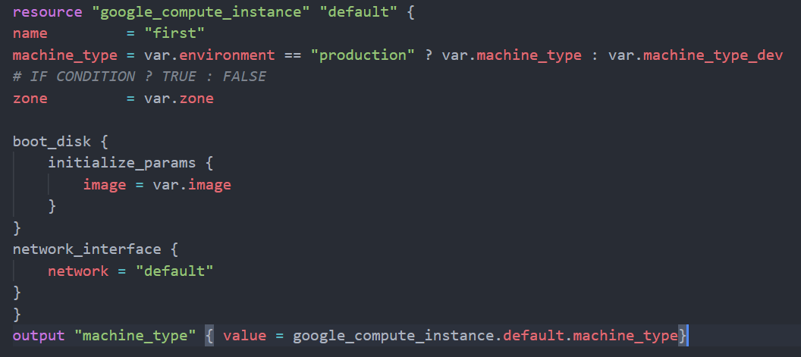
Conditional Expresions
A conditional expression uses the value of a bool expression to select one of two values.
The syntax of a conditional expression is as follows:
Condition ? true_value : false_value
If the condition is true, then the result is true_value. If condition is false, then the result is false_value

Slide 28
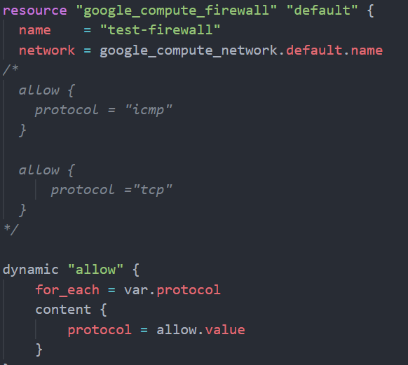
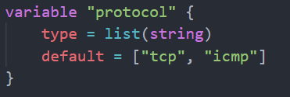
Dynamic Blocks
Within top-level block constructs like resources, expressions can usually be used only when assigning a value to an argument using the name = expression form. This covers many uses, but some resource types include repeatable nested blocks in their arguments, which do not accept expressions.
A dynamic block acts much like a for expression but produces nested blocks instead of a complex typed value. It iterates over a given complex value and generates a nested block for each element of that complex value.

Slide 29
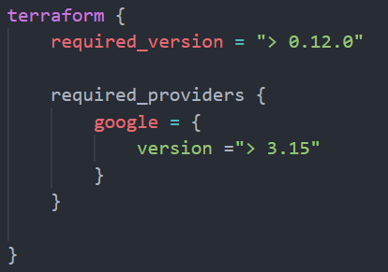
Terraform Settings
The special terraform configuration block type is used to configure some behaviors of Terraform itself, such as requiring a minimum Terraform version to apply your configuration.
Each terraform block can contain several settings related to Terraform's behavior. Within a terraform block, only constant values can be used; arguments may not refer to named objects such as resources, input variables, etc. And may not use any of the Terraform language built-in functions.
If a user tries to run Terraform and the code does not meet the requirements of the Settings configuration it will throw an error.
backend
workspaces
required_version
required_providers

Slide 30
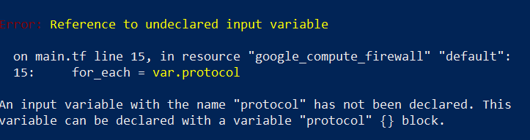
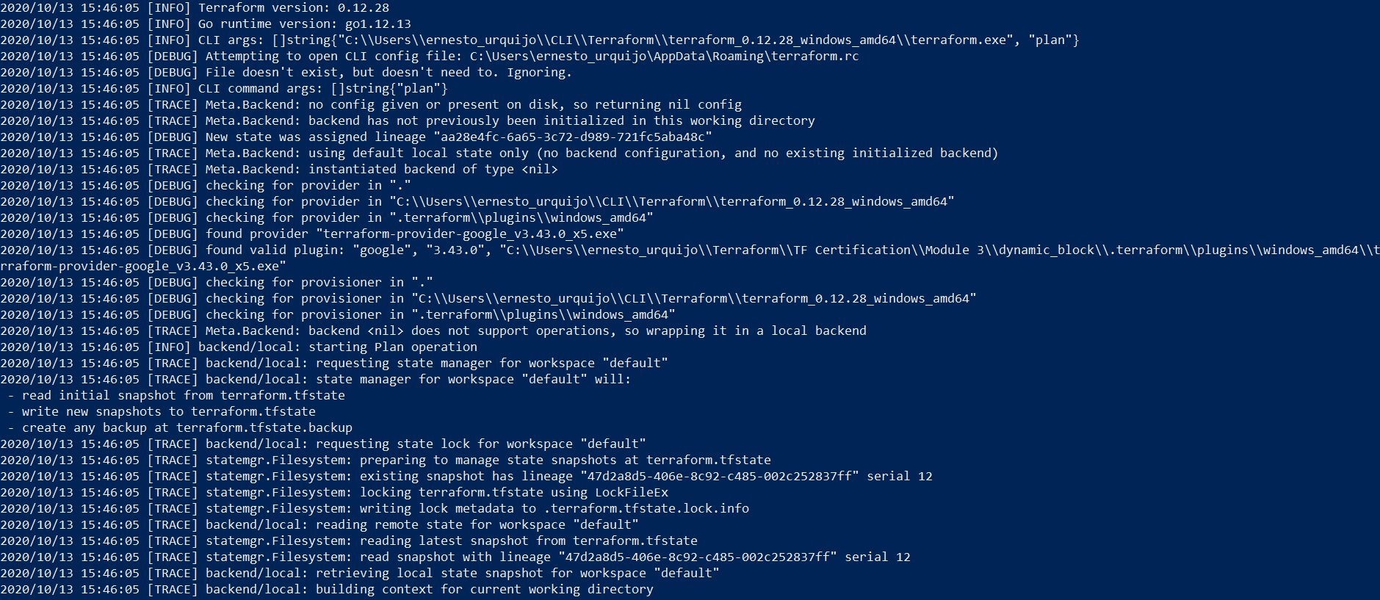
Debugging in Terraform
Terraform has detailed logs which can be enabled by setting the TF_LOG environment variable to any value. This will cause detailed logs to appear on stderr.
You can set TF_LOG to one of the log levels TRACE, DEBUG, INFO, WARN or ERROR to change the verbosity of the logs. TRACE is the most verbose and it is the default if TF_LOG is set to something other than a log level name, and is also the recommended log level according to Terraform.
To persist logged output you can set TF_LOG_PATH in order to force the log to always be appended to a specific file when logging is enabled. Note that even when TF_LOG_PATH is set, TF_LOG must be set for any logging to be enabled.
If you find a bug with Terraform, please include the detailed log by using a service such as gist.
TF_LOG not defined
TF_LOG=TRACE

Slide 31
Module 4: Terraform Modules and Workspaces

Slide 32
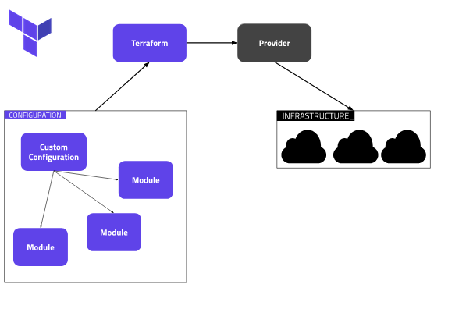

Modules(DRY principle)
A module is a container for multiple resources that are used together.
Every Terraform configuration has at least one module, known as its root module, which consists of the resources defined in the *.tf files in the main working directory.
A module can call other modules, which lets you include the child module's resources into the configuration in a concise way. Modules can also be called multiple times, either within the same configuration or in separate configurations, allowing resource configurations to be packaged and re-used.
By using modules, we can have a centralized source code and call it when required from multiple locations.
*After adding, removing, or modifying module blocks, you must re-run terraform init to allow Terraform the opportunity to adjust the installed modules.

Slide 33
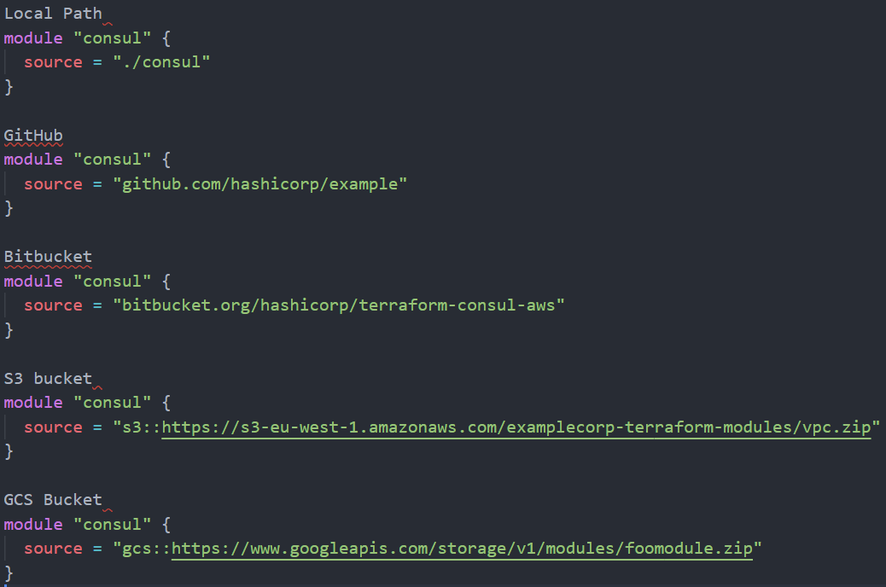
Modules Sources
The source argument in a module block tells Terraform where to find the source code for the desired child module.
Terraform uses this during the module installation step of terraform init to download the source code to a directory on local disk so that it can be used by other Terraform commands.
The module installer supports installation from several different source types, as listed below:
Local paths
Terraform Registry
GitHub
Bitbucket
Generic Git, Mercurial repositories
HTTP URLs
S3 buckets
GCS buckets

Slide 34
Module Variables
One common need on infrastructure management is to build environments like staging or production with similar setup but keeping environment variables different.
In order to achieve this your module configurations needs to declare the variables for the arguments that can be customized by the consumers in the same way was the previous lessons.
When we call the child module from our root module and pass the values of our variables in the module block.
Staging
machine_type=f1-micro
Production
machine_type=n1-standard-4

Slide 35
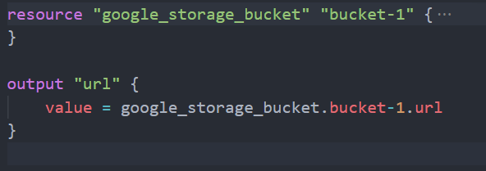
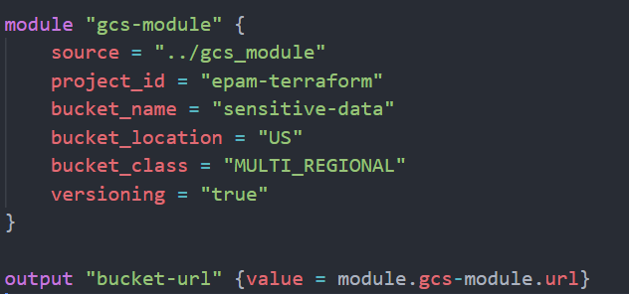
Module Outputs
The resources defined in a module are encapsulated, so the calling module cannot access their attributes directly. However, the child module can declare output values to selectively export certain values to be accessed by the calling module.
Once the output has been exported by the child module it can be consumed by the parent by referencing it in the following format
module.module_name.child_output_name

Slide 36
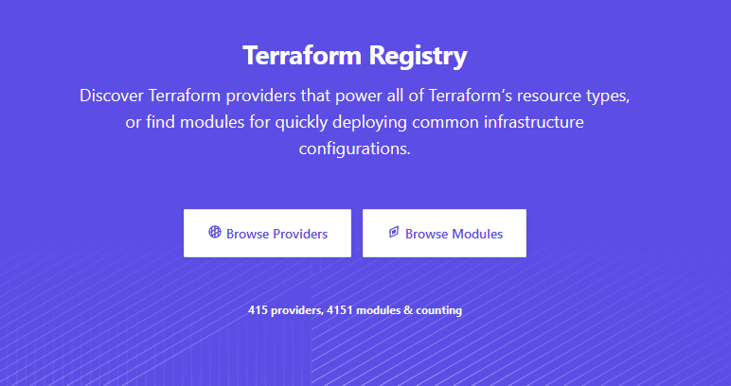
Terraform Registry
Terraform Registry is an index of modules shared publicly using this protocol. This public registry is the easiest way to get started with Terraform and find modules created by others in the community.
You can also use a private registry, either via the built-in feature from Terraform Cloud, or by running a custom service that implements the module registry protocol.
Modules on the public Terraform Registry can be referenced using a registry source address of the form <NAMESPACE>/<NAME>/<PROVIDER>, with each module's information page on the registry site including the exact address to use.
https://registry.terraform.io/

Slide 37
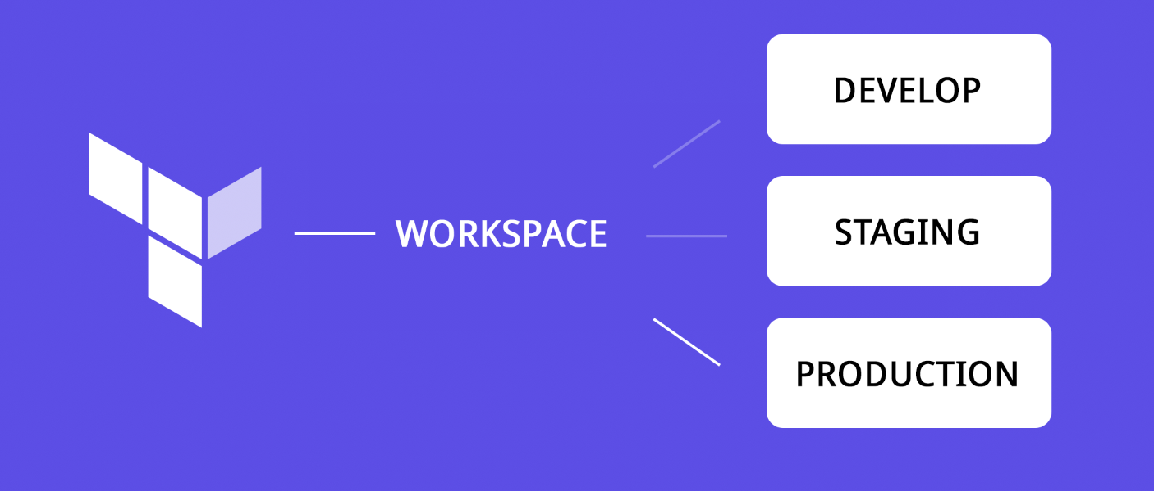
Workspaces
Each Terraform configuration has an associated backend that defines how operations are executed and where persistent data such as the Terraform state are stored.
The persistent data stored in the backend belongs to a workspace. Initially the backend has only one workspace, called "default", and thus there is only one Terraform state associated with that configuration.
Workspaces are technically equivalent to renaming your state file. They aren't any more complex than that.
Workspaces are stored by appending the workspace name to the state path.
The important thing about workspace internals is that workspaces are meant to be a shared resource. They aren't a private, local-only notion (unless you're using purely local state and not committing it).

Slide 38
Using Workspaces
Terraform starts with a single workspace named "default". This workspace is special both because it is the default and because it cannot ever be deleted. If you've never explicitly used workspaces, then you've only ever worked on the "default" workspace.
Workspaces are managed with the terraform workspace set of commands.
Named workspaces allow conveniently switching between multiple instances of a single configuration within its single backend. They are convenient in a few situations but cannot solve all problems.
A common use for multiple workspaces is to create a parallel, distinct copy of a set of infrastructure in order to test a set of changes before modifying the main production infrastructure.

Slide 39
Module 5: State Management

Slide 40
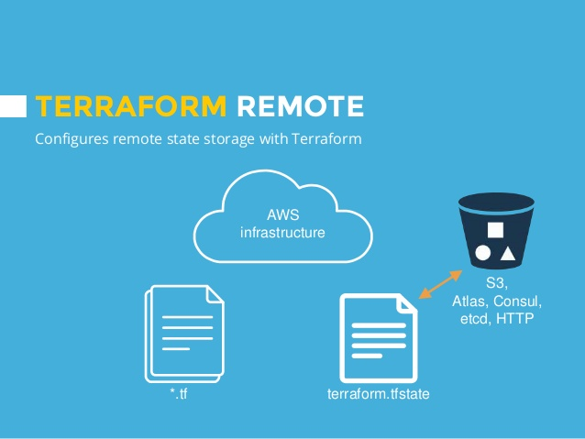
Remote Backend
By default, Terraform stores state locally in a file named terraform.tfstate.
When working with Terraform in a team, use of a local file makes Terraform usage complicated because each user must make sure they always have the latest state data before running Terraform and make sure that nobody else runs Terraform at the same time to avoid race conditions.
With remote state, Terraform writes the state data to a remote data store, which can then be shared between all members of a team. Terraform supports storing state in Terraform Cloud, HashiCorp Consul, Amazon S3, Azure Blob Storage, Google Cloud Storage, Alibaba Cloud OSS, and many more.
*Remember to rerun terraform init when you modify your backend configuration

Slide 41

State Locking
If supported by your backend, Terraform will lock your state for all operations that could write state. This prevents others from acquiring the lock and potentially corrupting your state.
State locking happens automatically on all operations that could write state. You won't see any message that it is happening. If state locking fails, Terraform will not continue. You can disable state locking for most commands with the -lock flag but it is not recommended.
Terraform has a force-unlock command to manually unlock the state if unlocking failed.
Be very careful with this command. If you unlock the state when someone else is holding the lock it could cause multiple writers. Force unlock should only be used to unlock your own lock in the situation where automatic unlocking failed.
To protect you, the force-unlock command requires a unique lock ID. Terraform will output this lock ID if unlocking fails.

Slide 42
State Modification
As your Terraform usage becomes more advanced , there are some cases where you may need to do operations on the Terraform state.
It is important to never modify the state file directly. Instead make use of terraform state command for advanced state management.
terraform state subcommands:
list
mv
pull
push
replace-provider
rm
show
*The Terraform state subcommands all work with remote state just as if it was local state. Reads and writes may take longer than normal as each read and each write do a full network roundtrip.

Slide 43
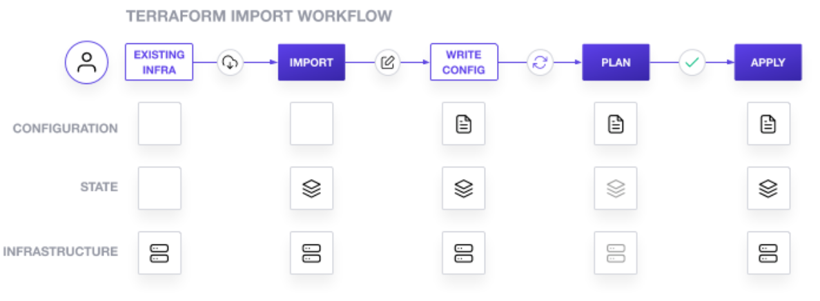
Terraform import
Terraform can import existing infrastructure. This allows you take resources you've created by some other means and bring it under Terraform management.
The current implementation of Terraform import can only import resources into the state. It does not generate configuration
Because of this, prior to running terraform import it is necessary to write manually a resource configuration block for the resource, to which the imported object will be mapped.

Slide 44
Module 6: Terraform Cloud and Enterprise Capabilities

Slide 45
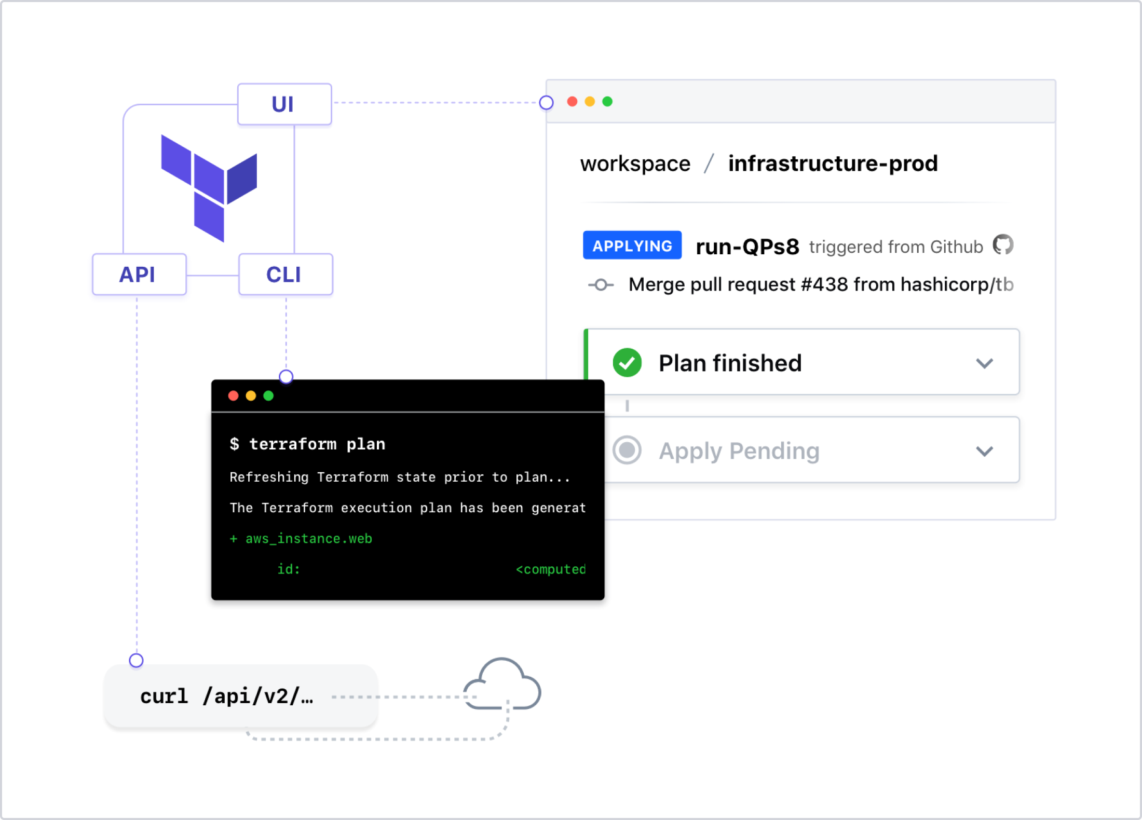
Terraform Cloud and Terraform Enterprise Overview
Terraform Cloud is a free to use, self-service SaaS platform that extends the capabilities of the open source Terraform CLI.
It manages Terraform runs in a consistent and reliable environment and includes easy access to shared state and secret data, access controls for approving changes to infrastructure, a private registry for sharing Terraform modules, detailed policy controls for governing the contents of Terraform configurations, and more.
Terraform Cloud is available as a hosted service at https://app.terraform.io and there are free accounts for small teams.
Large enterprises can purchase Terraform Enterprise, a self-hosted distribution of Terraform Cloud. It offers enterprises a private instance of the Terraform Cloud application, with no resource limits and with additional enterprise-grade architectural features like audit logging and SAML single sign-on.

Slide 46
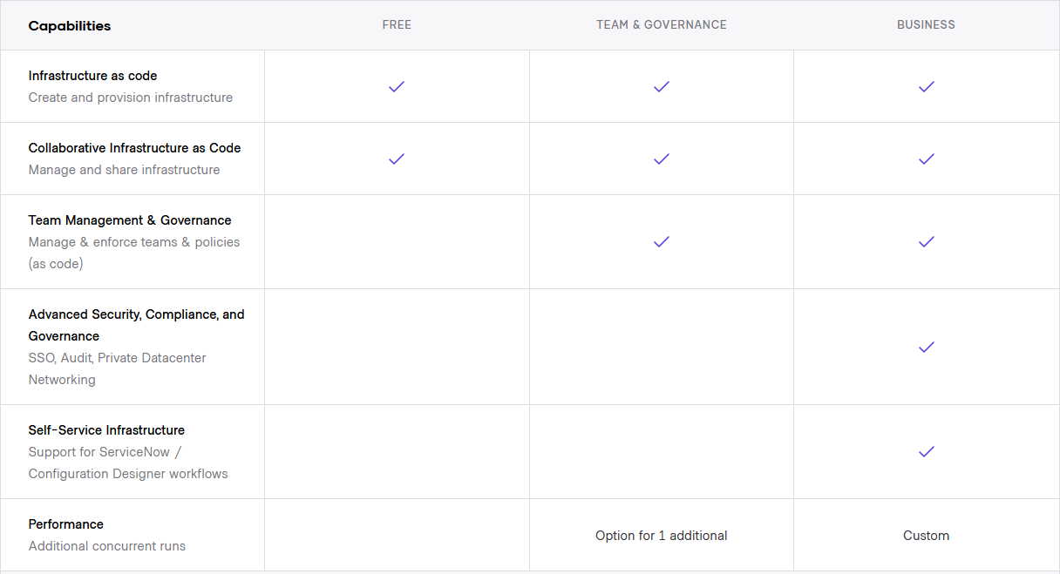
Differences per license version

Slide 47
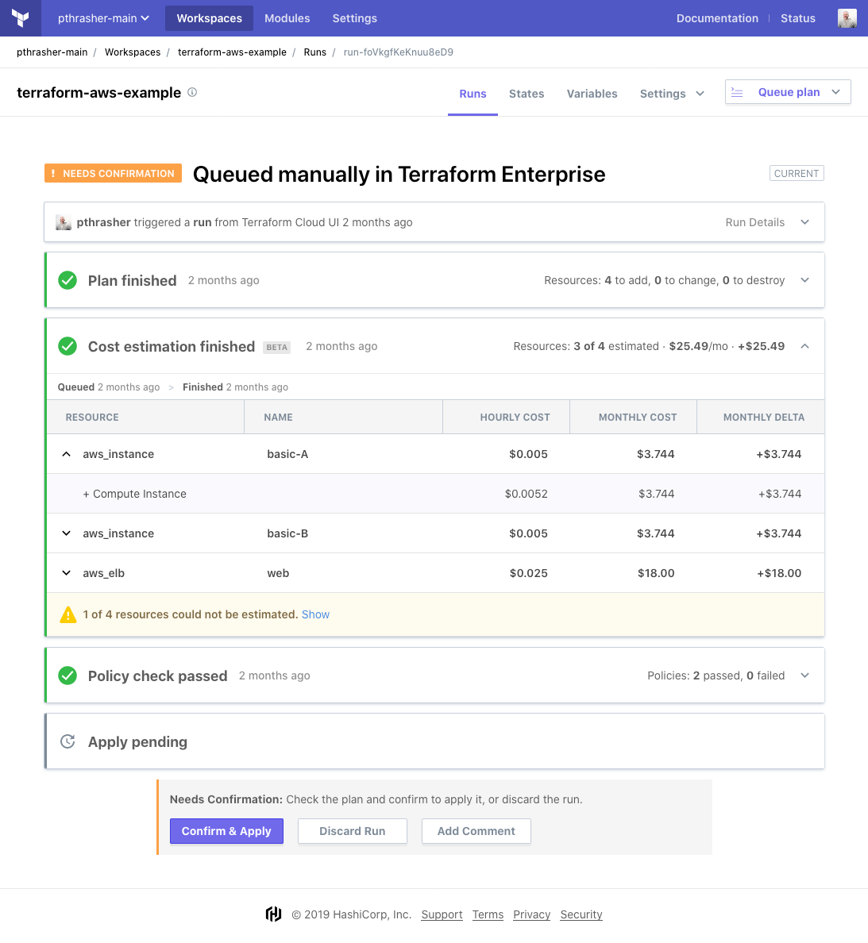
Terraform Cloud Cost Estimation (paid feature)
Terraform Cloud provides cost estimates for many resources found in your Terraform configuration. For each resource, an hourly and monthly cost is shown, along with the monthly delta.
When enabled, Terraform Cloud performs a cost estimate for every run. Estimated costs appear in the run UI as an extra run phase, between the plan and apply.
The estimate displays a total monthly cost by default; you can expand the estimate to see an itemized list of resource costs, as well as the list of estimated resources.
Note that this is just an estimate; some resources don't have cost information available or have unpredictable usage-based pricing.

Slide 48
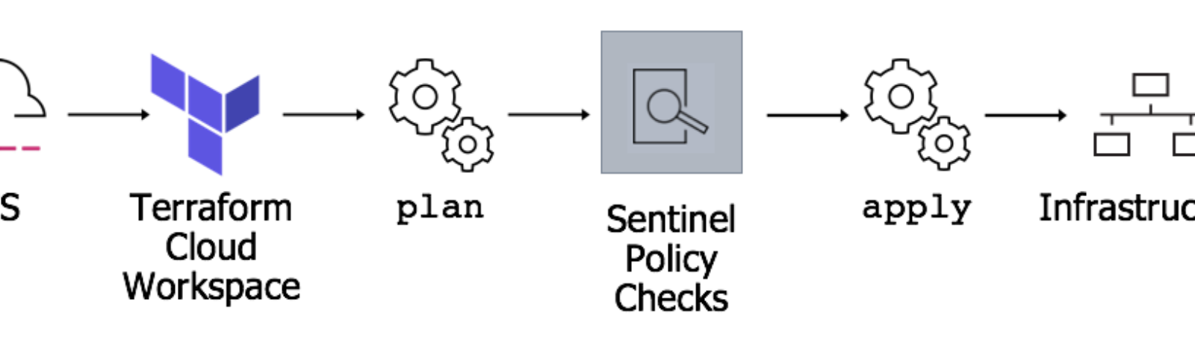
Sentinel
Sentinel is an embedded policy-as-code framework integrated with the HashiCorp Enterprise products. It enables fine-grained, logic-based policy decisions, and can be extended to use information from external sources.
Using Sentinel with Terraform Cloud involves:
Defining the policies - Policies are defined using the policy language with imports for parsing the Terraform plan, state and configuration.
Managing policies for organizations - Users with permission to manage policies can add policies to their organization by configuring VCS integration or uploading policy sets through the API. They also define which workspaces the policy sets are checked against during runs.
Enforcing policy checks on runs - Policies are checked when a run is performed, after the terraform plan but before it can be confirmed or the terraform apply is executed.
Mocking Sentinel Terraform data - Terraform Cloud provides the ability to generate mock data for any run within a workspace. This data can be used with the Sentinel CLI to test policies before deployment.

Slide 49
Exam Overview
Prerequisites
Basic terminal skills
Basic understanding of on premises and cloud architecture
Product Version Tested
Terraform 0.12 and higher.
Assessment Type | Multiple Choice
Format | Online proctored
Duration | 1 hour
Price | $70.50 USD
Language | English
Expiration | 2 years

